Slide 1
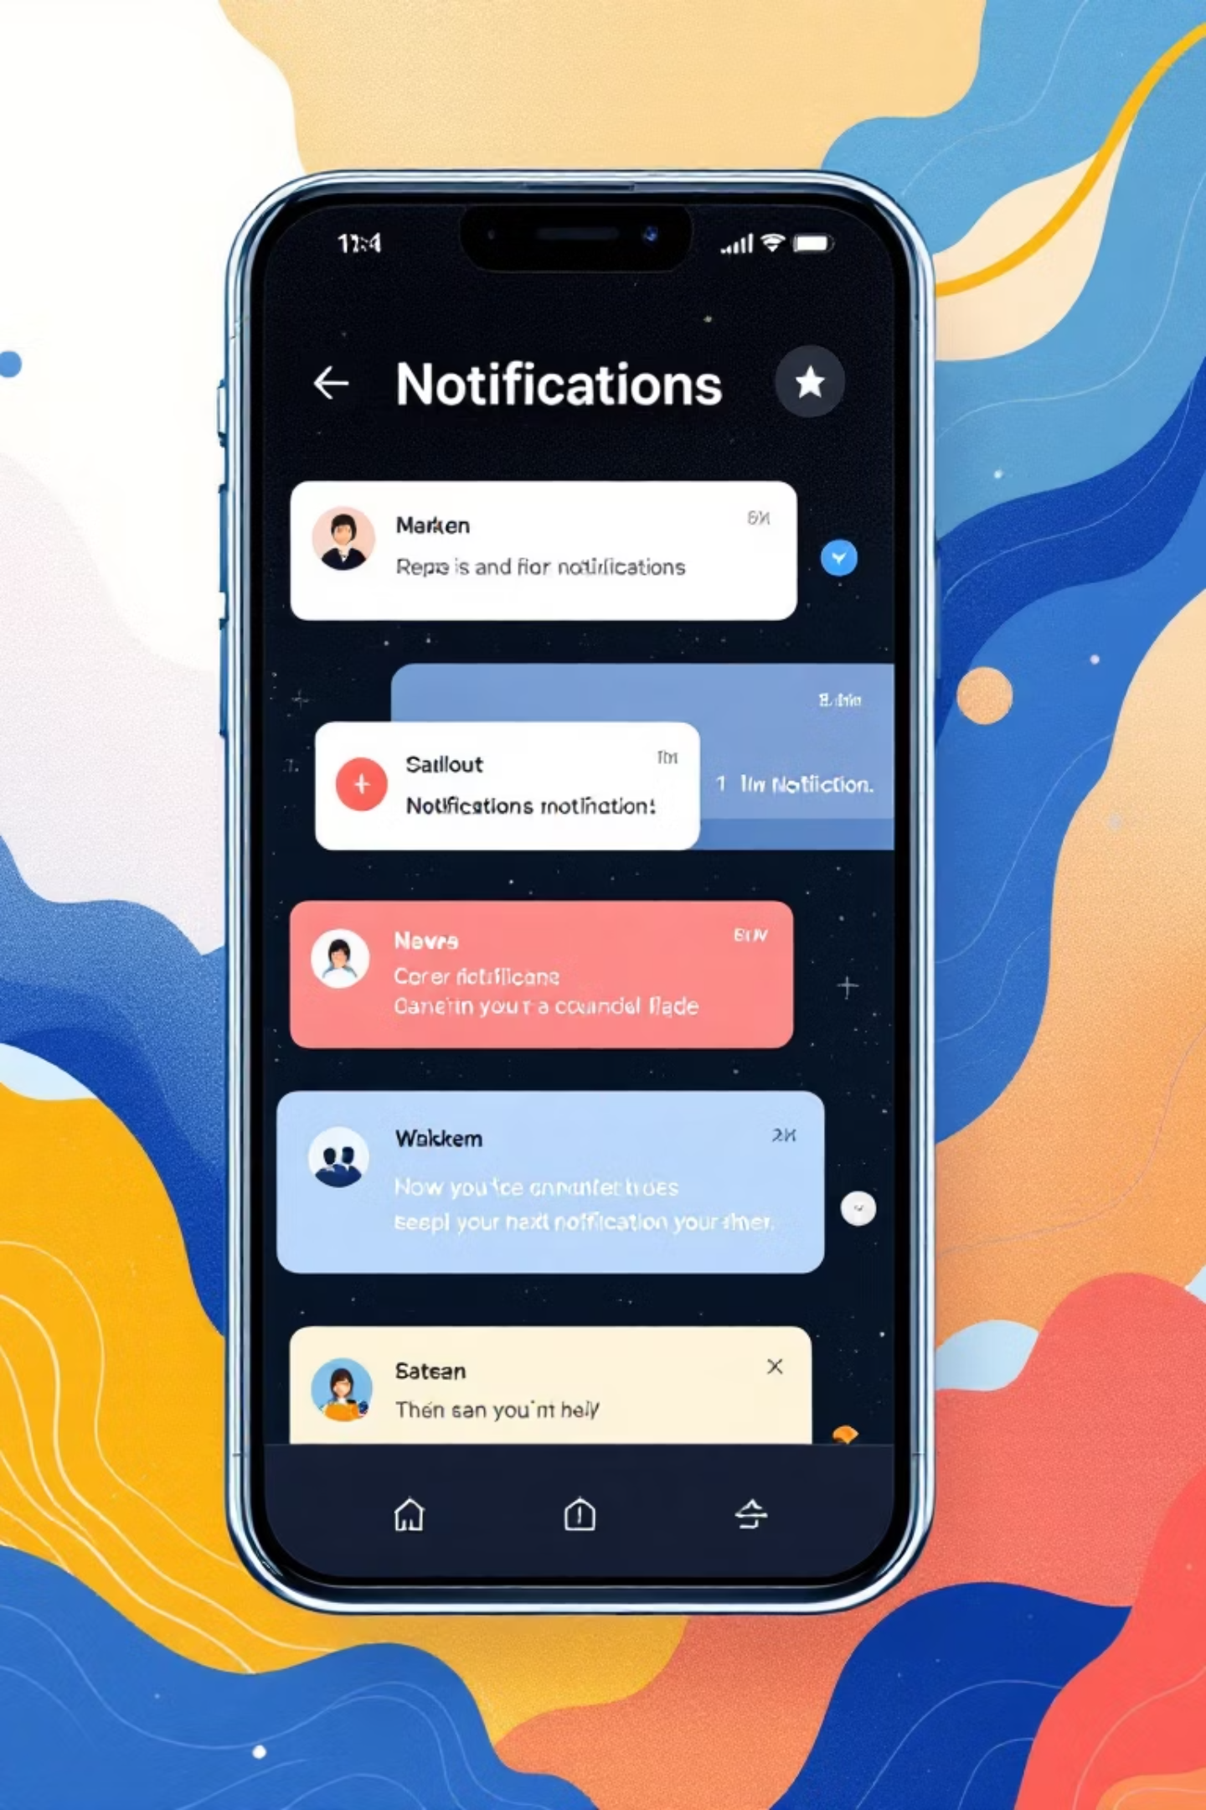
Notification Management System
A Java-Based Application for Intelligent Alert Handling
By K. Vamsi Raghu Ram

Slide 2
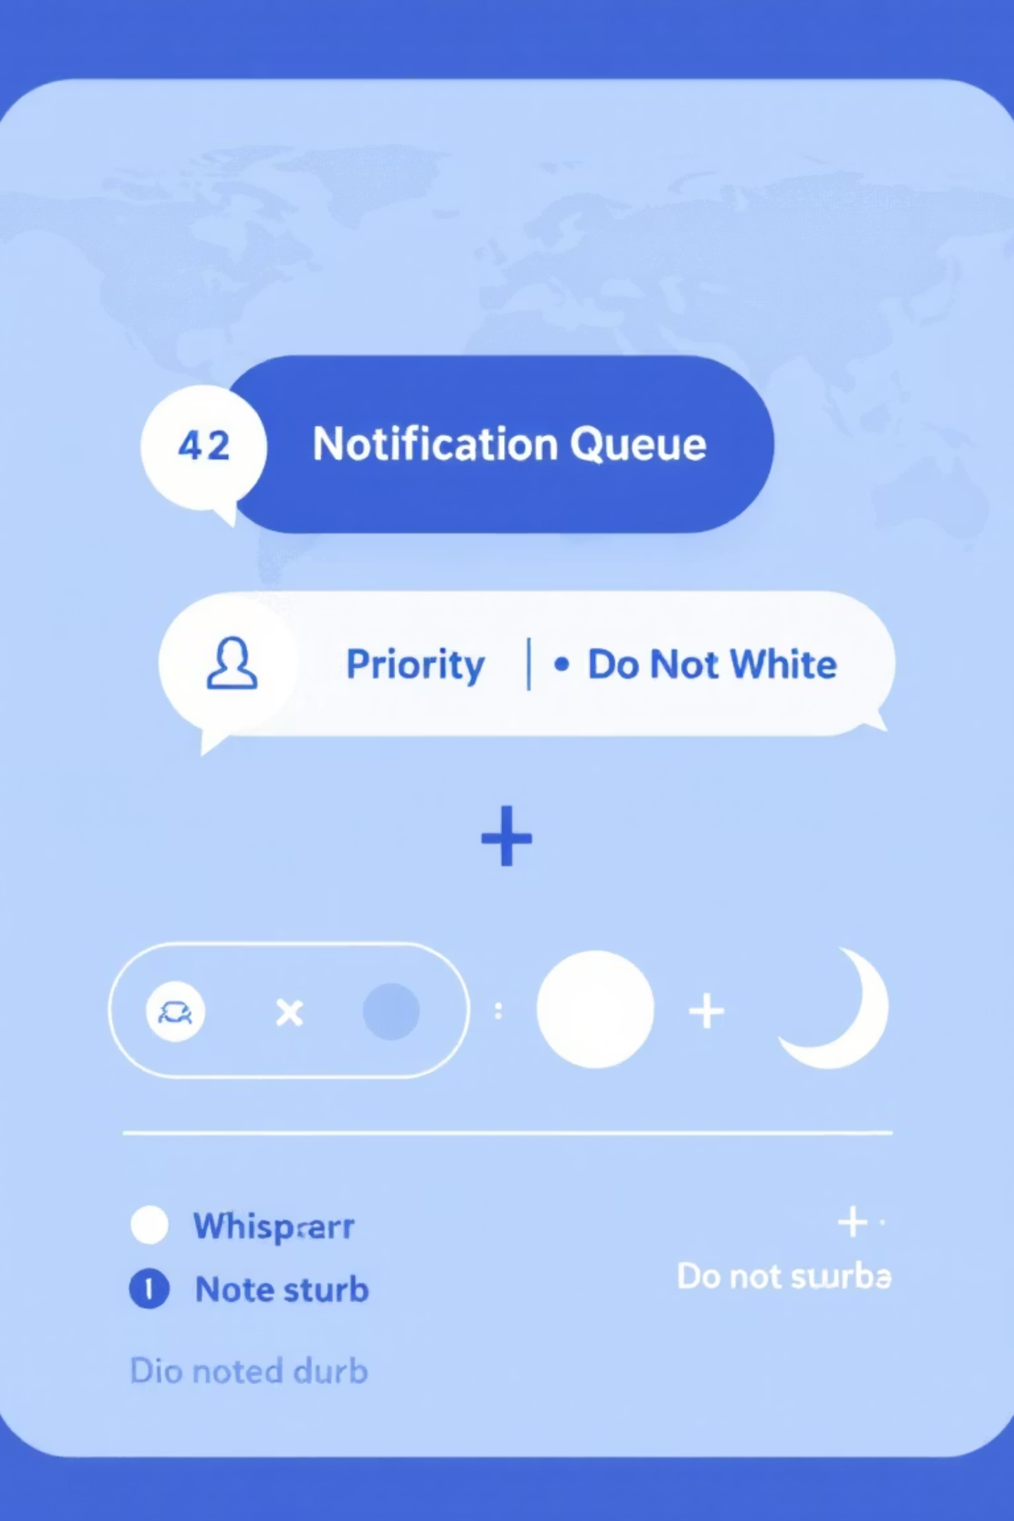
Project Overview
The Notification Management System is a Java-based application designed to intelligently manage, process, and log different types of notifications including calls and messages. At its core, it introduces a "Do Not Disturb (DND)" feature that automatically handles incoming notifications based on user availability and priority levels. Urgent notifications bypass DND restrictions and display immediately, while non-urgent alerts are queued and presented after the DND period concludes.

Slide 3

The Problem We're Solving
Information Overload
Lost Urgent Messages
No Audit Trail
Users receive constant notifications that interrupt critical tasks, reducing focus and productivity during important work periods.
Manual filtering leads to missed critical alerts. Without automated prioritization, truly important notifications get buried.
Most systems lack comprehensive logging, making it impossible to review historical notifications or track communication patterns.

Slide 4
System Objectives & Goals
Smart Filtering
DND Implementation
Automatically categorize and prioritize notifications based on urgency levels and user-defined rules.
Deploy multithreaded Do Not Disturb functionality that defers non-urgent alerts while respecting urgent priorities.
Type Categorization
Persistent Logging
Distinguish between Calls and Messages, applying different handling strategies to each notification type.
Maintain comprehensive records of all missed or delayed notifications in a persistent file for review and analysis.

Slide 5
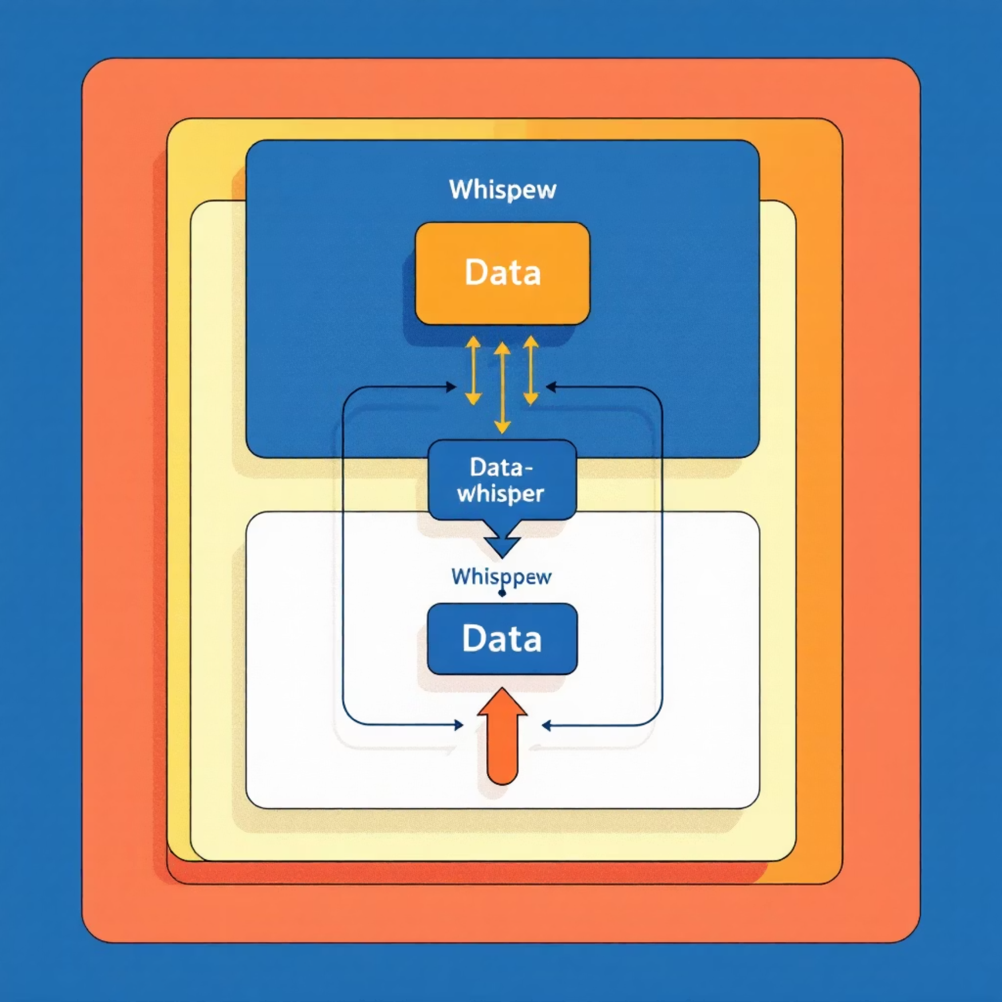
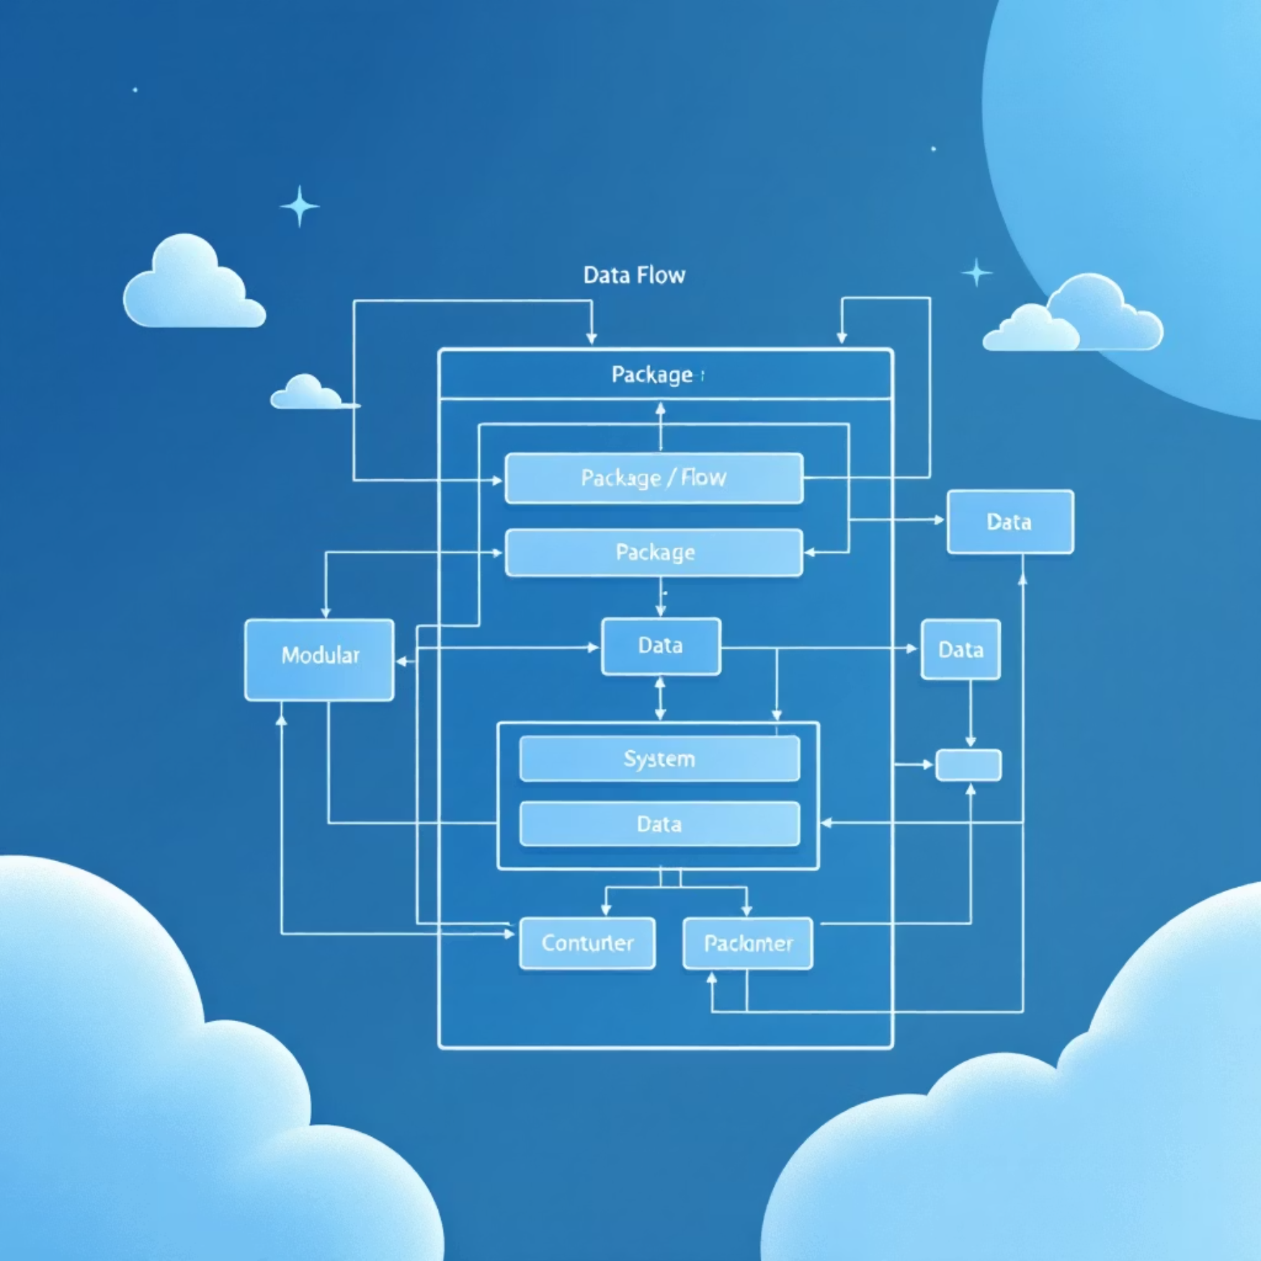
System Architecture & Design
Data Flow
User Input → Main Controller → TimerManager (DND Control) → NotificationManager (Queue Processing) → FileHandler (Logging) → Display & Persistence
Modular Package Structure
model – Defines notification types and base abstractions
service – Manages timing, DND control, and notification queuing
utils – Handles file operations and persistence
Main – Controls program execution and u

Slide 6
Core Class Hierarchy & Design Patterns
The system employs object-oriented principles through inheritance and polymorphism:
Notification
1
Abstract base class defining core notification properties and behaviors.
CallNotification
2
Concrete class inheriting from Notification, handling phone call alerts with caller identification.
MessageNotification
3
Concrete class inheriting from Notification, processing text and instant message content.
NotificationManager
4
Manages notification queue, processes DND logic, and coordinates notification delivery timing.
TimerManager
5
Controls active DND period duration and state transitions using multithreading.

Slide 7
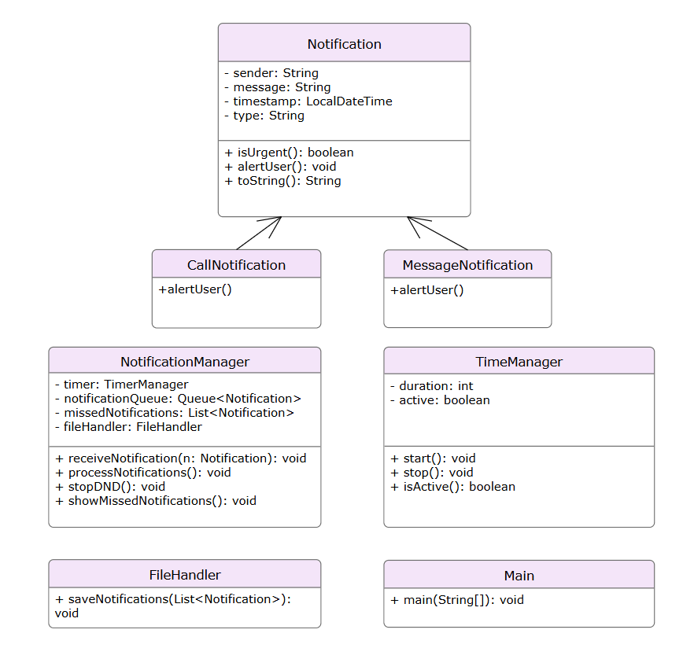
UML Class Diagram

Slide 8
Technical Implementation Details
Language & Environment
Java SE 21 with standard library utilities
1
2
Object-Oriented Design
Multithreading Architecture
Inheritance for type hierarchies, abstraction for common behaviors, polymorphism for flexible notification handling.
TimerManager and NotificationManager execute on separate threads, ensuring non-blocking DND control and responsive notification processing.
3
4
File Persistence
Priority Logic
All missed and deferred notifications logged to notifications_log.txt for audit trail and historical analysis.
Urgent notifications bypass DND restrictions and display immediately; standard notifications queue until DND period expires.

Slide 9
Execution Flow & Example Output
User Activates DND
1
DND mode enabled for 30 seconds; TimerManager initiates countdown.
2
Notifications Arrive
Multiple calls and messages received during DND period; incoming alerts routed to NotificationManager.
Priority Processing
3
Urgent messages marked as priority bypass DND and display immediately; standard notifications queued.
4
DND Expires
30-second timer completes; queued notifications displayed to user in chronological order.
Log & Persist
5
All notifications recorded with timestamps in notifications_log.txt file for future reference.

Slide 10

Future Enhancements & Real-World Applications
Planned Enhancements
System Benefits
Graphical UI (JavaFX/Swing) for improved usability
Significantly reduces interruptions during focused work
Relational database backend replacing text file logs
Guarantees urgent alerts are never missed
Multi-user push notification support
Provides comprehensive audit trail for compliance
Email/SMS forwarding for critical alerts
Demonstrates production-grade software engineering practices
Machine learning-based priority classification
Easily extensible for enterprise notification platforms

Slide 11

Conclusion & Key Takeaways
Integrated Design
Software Excellence
Successfully combines multithreading, file handling, and object-oriented principles in a cohesive Java application.
Demonstrates core engineering concepts: modularity, concurrency control, data persistence, and scalability.
Real-World Ready
Project architecture provides a foundation for expanding into enterprise-grade notification systems serving millions of users.

